Slide 1
SECURE DATA HIDING IN IMAGES USING STEGANOGRAPHY
CAPSTONE PROJECT
Presented By:
Student Name : SRUJAN KUMAR SURA
College Name & Department : SATHYABAMA INSTITUTE OF SCIENCE AND TECHNOLOGY – CSE(AI)

Slide 2
OUTLINE
Problem Statement
Technology used
Wow factor
End users
Result
Conclusion
Git-hub Link
Future scope

Slide 3
Problem Statement
Need for secure communication.
Traditional encryption is noticeable; steganography hides data within images.
Importance of confidentiality.

Slide 4
Technology used
Frontend: HTML, CSS
Backend: Flask (Python)
Libraries: OpenCV (cv2), os
Storage: Local file system (uploads folder)

Slide 5
Wow factors
Hides messages in images without altering visibility 📷🔒
Password protection for added security 🔑
Fast encoding and decoding process ⚡
User-friendly web interface 🎨

Slide 6
End users
Journalists & Whistleblowers 📰
Security & Intelligence Agencies 🕵️‍♂️
Personal Use for Private Messaging 🔏
Digital Watermarking & Copyright Protection ©️

Slide 7
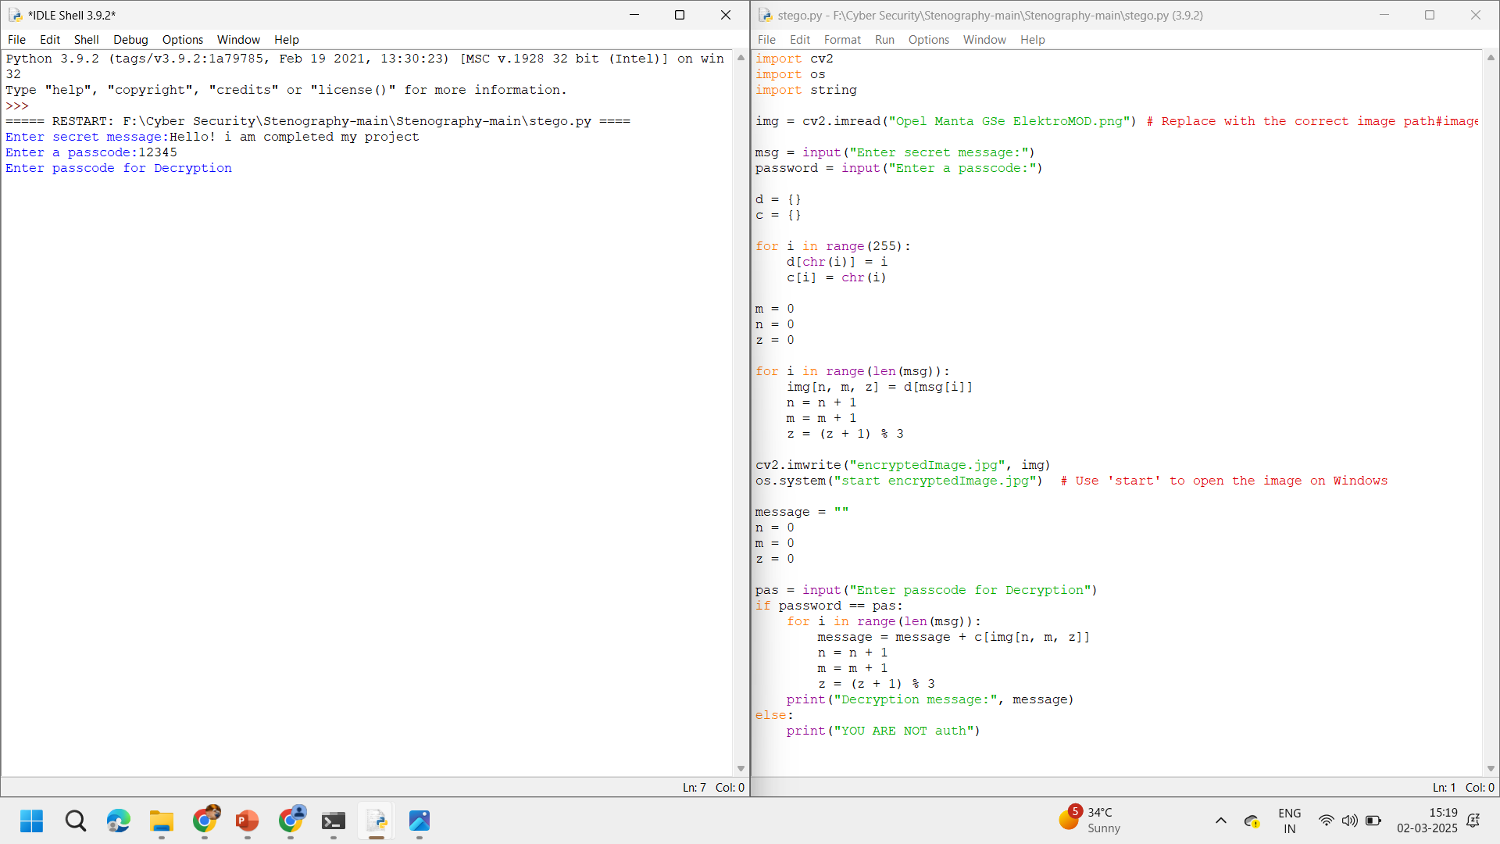
Results

Slide 8
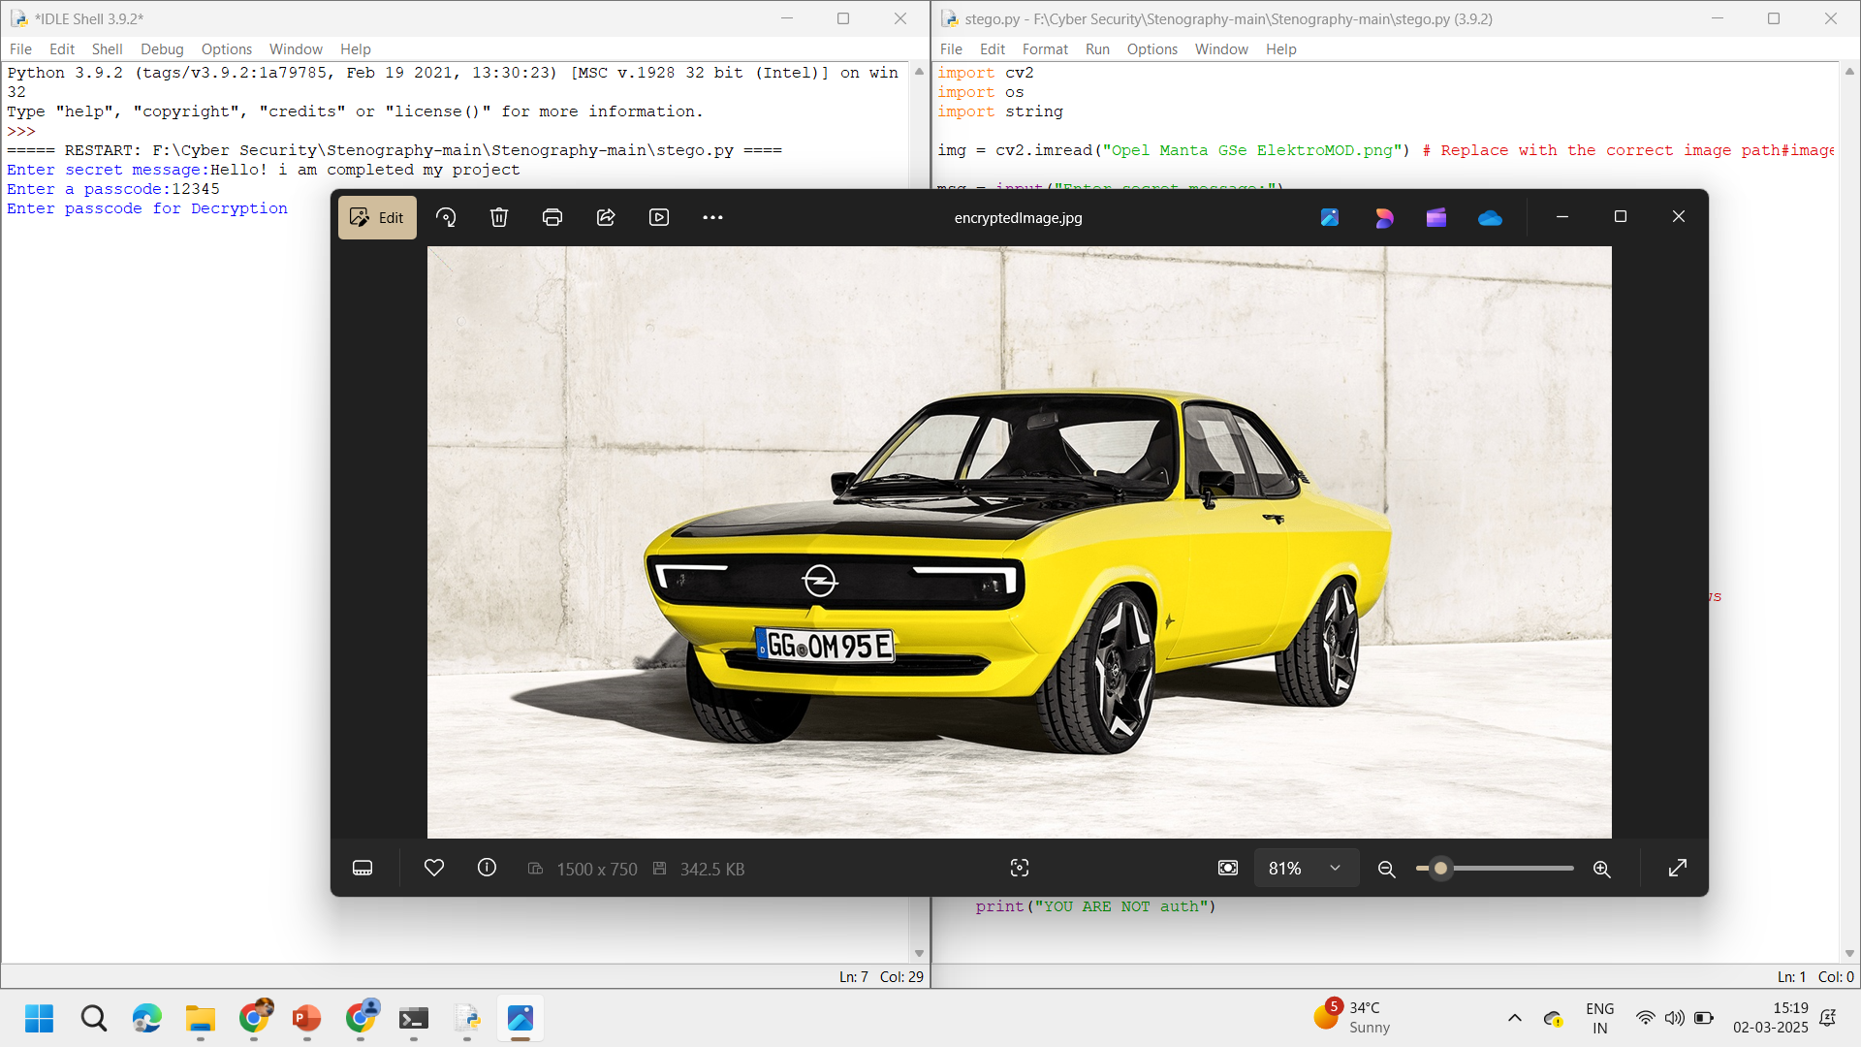
Results

Slide 9
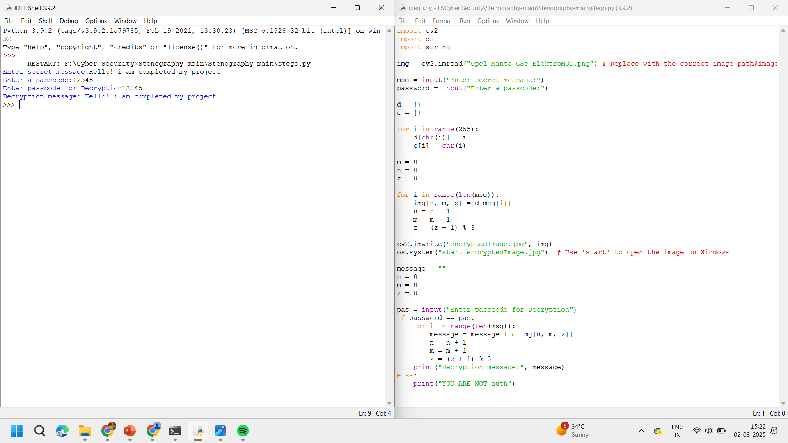
Results

Slide 10
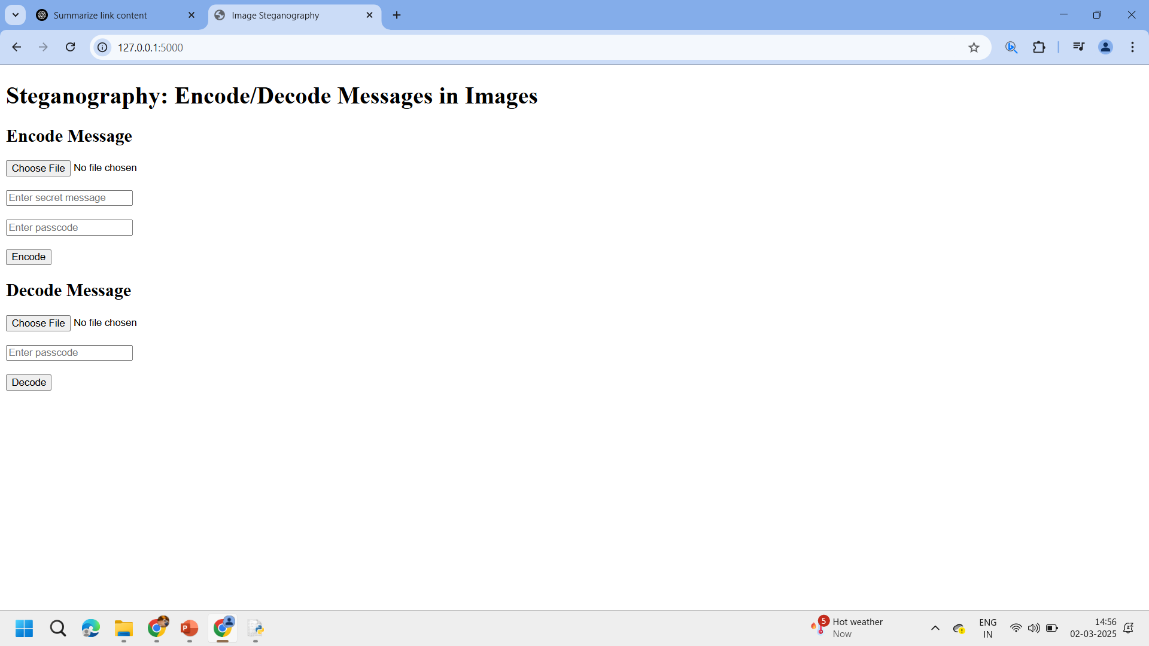
Results

Slide 11
Conclusion
Achieves secure, hidden message transmission.
Flask provides an accessible web interface.
Could be further optimized for larger images and different file formats.

Slide 12
GitHub Link
https://github.com/bunnysura/AICTE_CYBERSECURITY_Project.git

Slide 13
Future scope(optional)
Support for multiple image formats (PNG, GIF, etc.)
Mobile app integration 📱
Advanced encryption before embedding 🔐
Cloud storage for secure message retrieval ☁️
AI-based steganalysis detection improvements 🤖

Slide 14
THANK YOU

